Slide 1

Olive Branch Network
Stake - Earn - Give Back
olivebranch.network
dapp.olivebranch.network

Slide 2
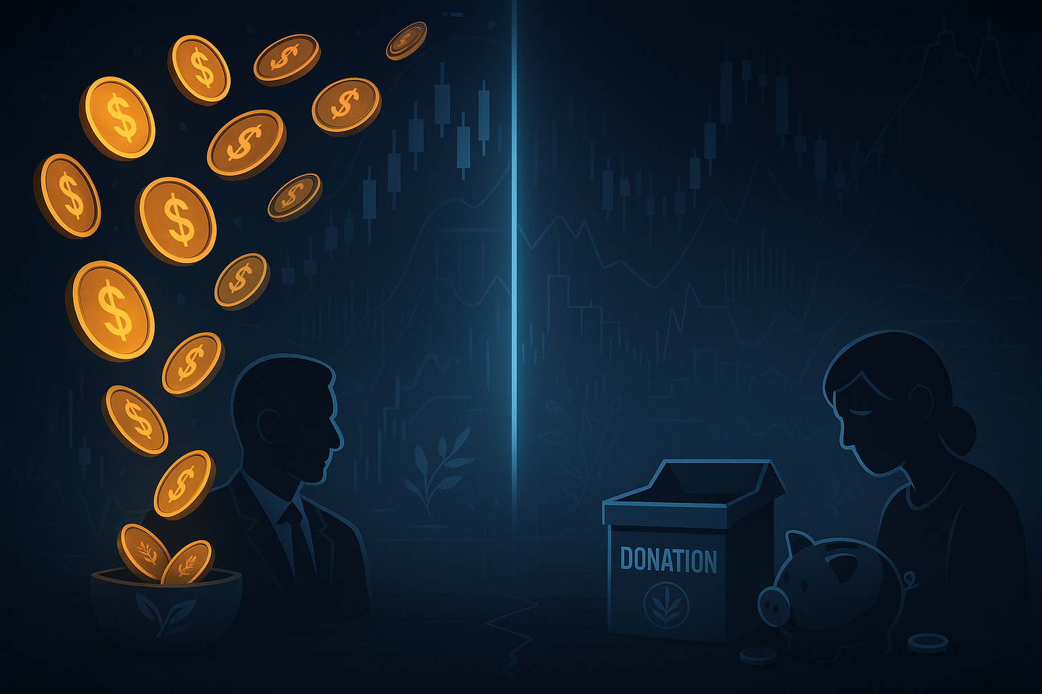
The Problem
The current model of philanthropy is outdated
Nonprofits struggle with sustainable, reliable funding
Current DeFi lacks real-world impact beyond speculation

Slide 3

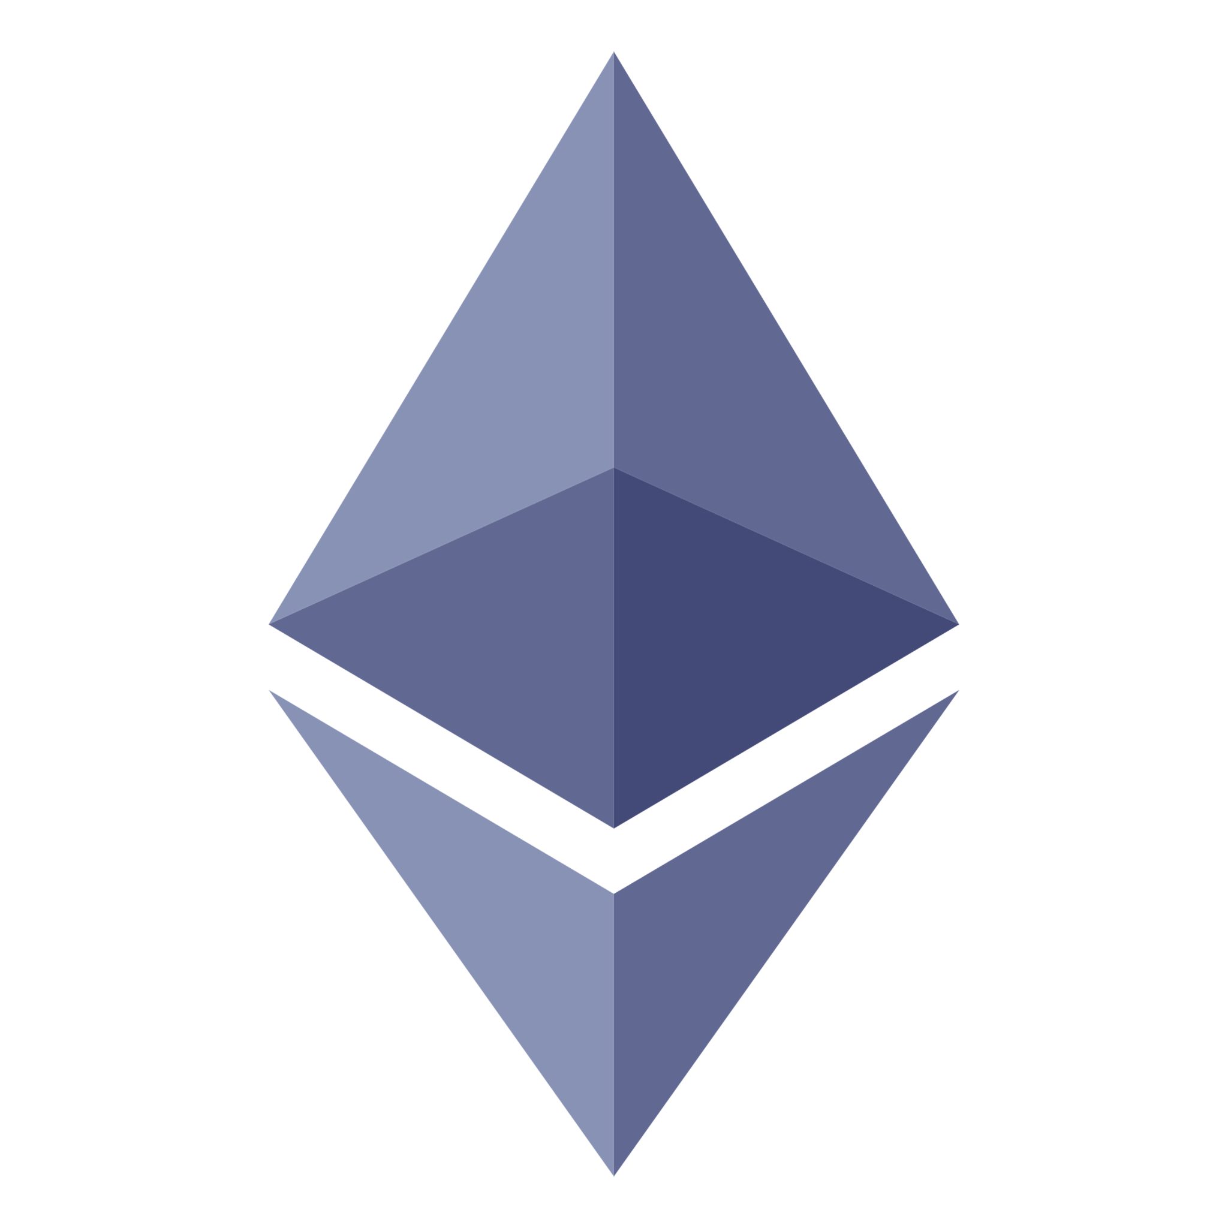
The Solution
Olive Branch Network
Olive Branch Network: A decentralized staking protocol that automatically funds nonprofits while rewarding stakers.
Built on Ethereum L2 (Base) → low fees, fast transactions, and Ethereum security.
Fully Open Source → transparent codebase on GitHub, ensuring accountability, security audits, and community-driven innovation.
Base
Ethereum

Slide 4
How it Works (Tokenomics Split)
Reward split from staking:
88% → Stakers
10% → Nonprofits
1% → Charity Fund
1% → Treasury
(Every stake strengthens the ecosystem + supports nonprofits)

Slide 5
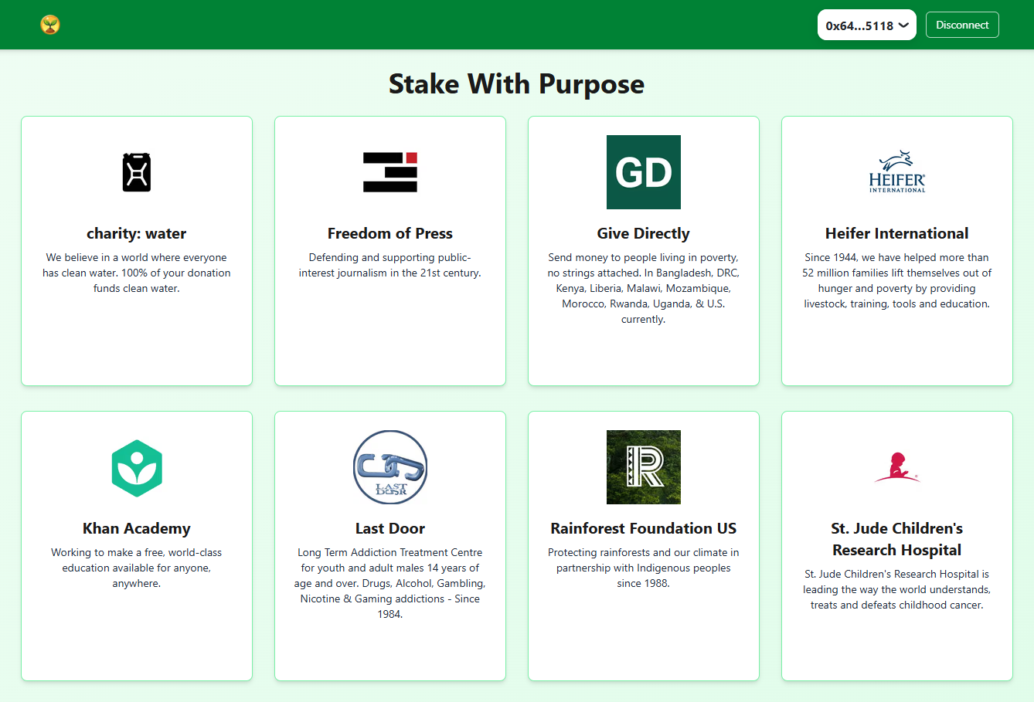
User Choice in dApp
Users select nonprofits directly in the OBN dApp.
Rewards are universal across pools → no chasing APYs.
Users pick causes they care about, not the “highest yield.”

Slide 6
Bootstrap Permalock Mechanism
Each nonprofit onboarded gets 1,000,000 OBN permanently staked.
Nonprofit receives instant staking rewards.
Permanently locks tokens out of circulation → reduces supply.
Charity fund refills automatically via 1% of every stake → continuous onboarding.

Slide 7
The Sustainability Loop
Staking → Nonprofits → Charity Fund → New Onboarding → More OBN Locked → Back to Staking.
Creates constant demand + shrinking supply.
Nonprofits bring new communities.
Ecosystem grows stronger with each stake.

Slide 8
Deflationary Emission Schedule
Years 1–2: 10% emissions
Years 3–4: 7.5%
Years 5–6: 5%
Years 7–8: 2.5%
Years 9–10: 1.25%
📉 Gradual reduction = fewer new tokens → long-term sustainability.

Slide 9
Market Opportunity
Global nonprofit donations: $500B+ annually.
Global staking market: tens of billions locked in DeFi protocols.
OBN merges both worlds → positioning at the intersection of DeFi + Impact.

Slide 10
Roadmap
Phase 1 (Done): Token launch + DEX liquidity + first nonprofits onboarded.
Phase 2 (Done): Staking pools + Olive Branch Network v1.0 app live.
Phase 3 (Done): Ownership passed to Timelock Controller + Gnosis Safe.
Phase 4 (Done): OBN App Upgrades
Phase 5: Exchange listings + community growth + community education.
Phase 6: Governance passed to DAO

Slide 11
Closing Call to Action
“Olive Branch Network is more than a token — it’s a decentralized system where earning and giving are woven together.”
Official website: www.olivebranch.network
Application: www.dapp.olivebranch.network
Github: https://github.com/jdmaverick369/olive-branch-network
Whitepaper: https://github.com/jdmaverick369/olive-branch-network/releases/tag/v1.0

Slide 12
Founder
Jack Nguyen - Founder & Developer, Olive Branch Network
Houston, Texas: Born and raised, still based there today.
Early Blockchain Pioneer – Adopted Bitcoin during the Silk Road era, experimented with Ethereum smart contracts from the beginning.
Professional Background – Career in healthcare and teaching, where values of service, trust, and resilience were ingrained.
Self-Taught Builder – Learned coding through relentless practice, AI collaboration, and a vision for blockchain’s potential beyond speculation.
Mission-Driven Creator – Founded Olive Branch Network to prove blockchain can be sustainable, charitable, and impactful — transforming every stake into support for nonprofits.

